Slide 1


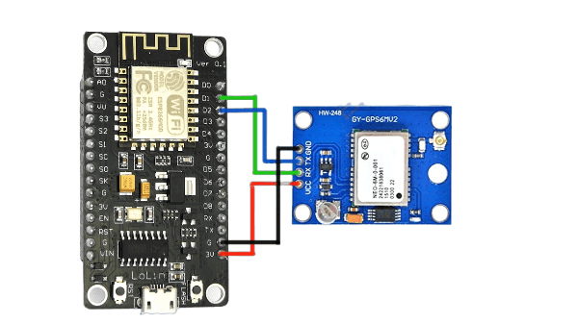
SMART GPS TRACKER USING NEO 6M GPS MODULE AND WIFI MODULE

Slide 2
what is Neo-6m GPS Module
What is NodeMCU Wifi Module
Components
Working Principle
Addvantages
Applications
Real Life Examples
Connection Of GPS Module With Wifi Module
Program and Output Of Neo-6m GPS Module
Video Output of GPS Module With WIFI Module
Conclusion
CONTENT

Slide 3
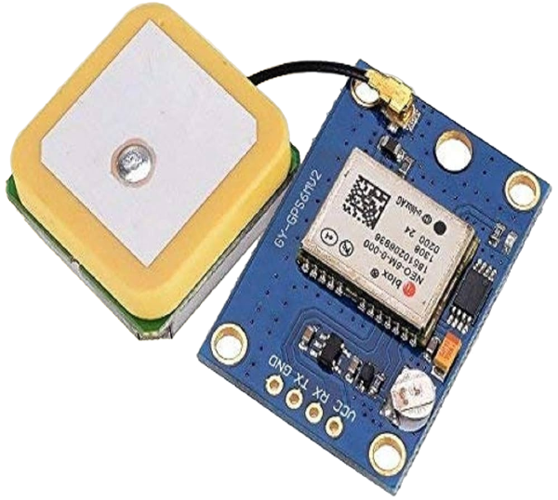
What Is Neo-6m GPS Module
The NEO-6M is a low-power Global Positioning System (GPS) module made by u-blox that can track up to 22 satellites and identify locations globally. It has a built-in antenna, GPS receiver, and non-volatile memory (EPROM) for storing configuration settings or other data.
It's commonly used in applications that require accurate positioning and navigation, such as geolocation and tracking.

Slide 4
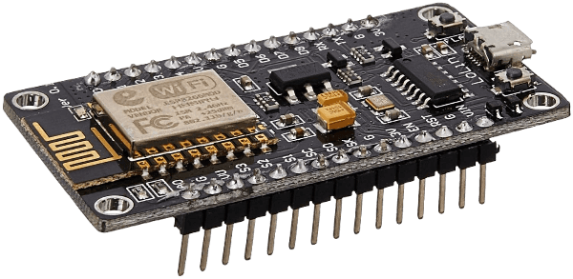
What is NodeMCU Wifi Module
Wifi modules are used to send and receive data over Wi-Fi. They can also accept commands over the Wi-Fi. Wi-Fi modules are used for communication between devices. They are most commonly used in the field of Internet of Things.
The NodeMCU Wi-Fi module is a tiny electronic device that enables other gadgets to connect to the internet wirelessly. It acts as a communication hub, allowing devices to send and receive data without needing physical cables.

Slide 5
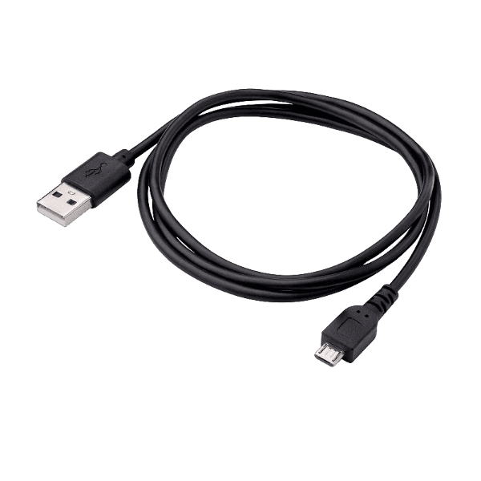
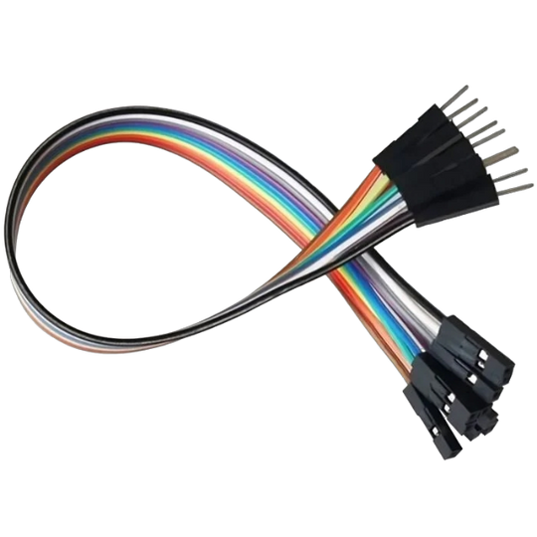
Components
NODEMCU WIFI MODULE
NEO-6M GPS MODULE
CONNECTOR WIRE
JUMPER WIRES

Slide 6
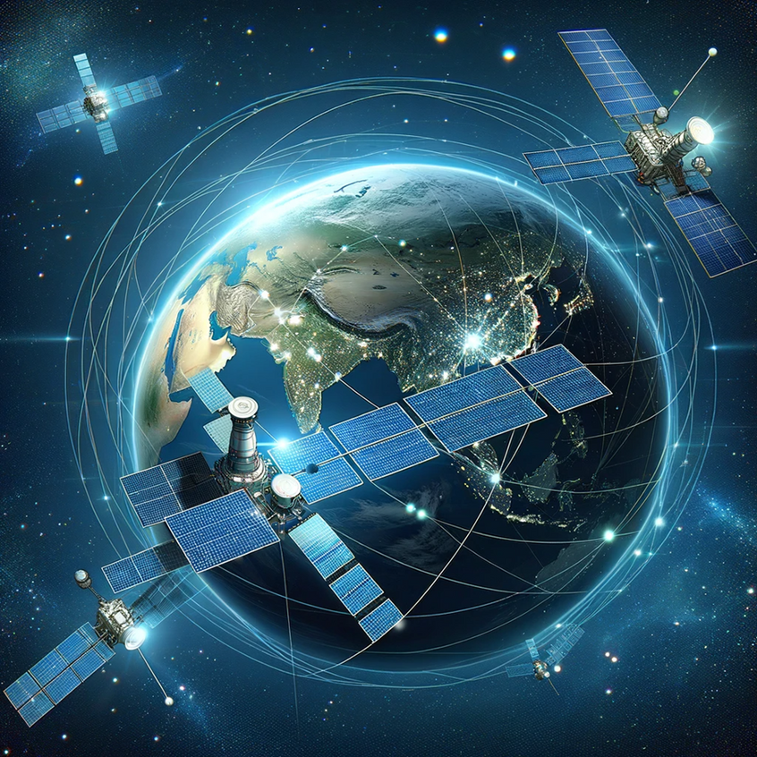
WORKING PRINCIPLE
The NEO-6M GPS module receives signals from satellites to find the device exact location. The GPS module provides accurate location information, while the Wi-Fi module enables wireless communication.
Additionally, the device can use the Wi-Fi module to transmit the location data over the internet to other devices or servers, enabling real-time tracking or remote monitoring.
For example, a GPS module with a Wi-Fi module could transmit its location to a server using Wi-Fi connectivity, allowing users to track its location via a web or mobile application.

Slide 7
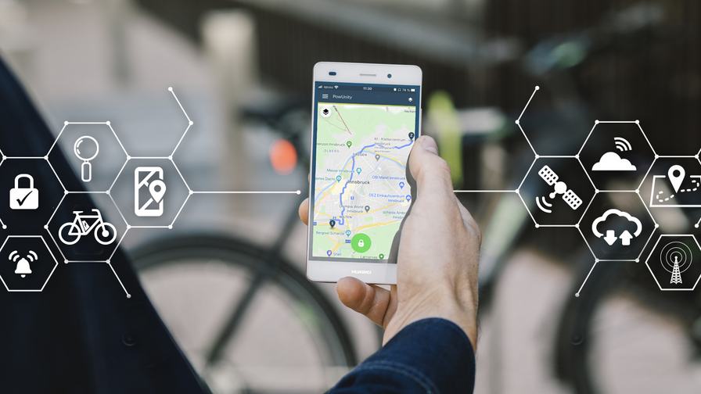
ADVANTAGES
1. LOCATION AWARENESS WITH CONNECTIVITY:
By combining GPS and WiFi capabilities, you can obtain accurate location data from the GPS module while simultaneously being able to connect to the internet via WiFi. This allows for real-time tracking.
2. REAL-TIME DATA SHARING:
By combining GPS with WiFi, you can transmit location data in real-time to a server or cloud platform. This enables applications like live tracking, fleet management, and location-based notifications.
3.ENHANCED COVERAGE:
While GPS works well in outdoor environments, it can be less reliable in urban areas with tall buildings. Wi-Fi positioning can fill in these gaps, providing location information even when GPS signals are unavailable.

Slide 8
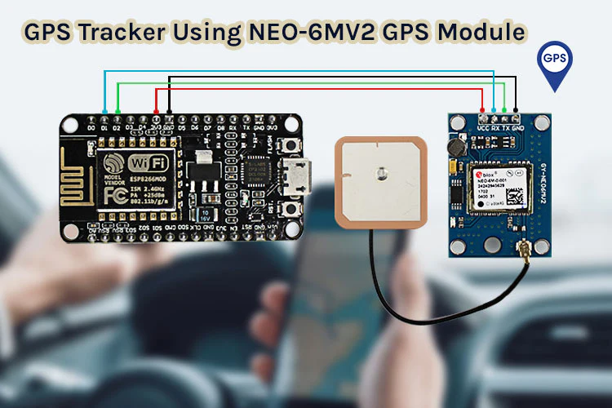
APPLICATIONS
1. PERSONAL TRACKERS AND WEARABLES:
Personal tracking devices, such as fitness trackers or pet trackers, can utilize the GPS module with Wi-Fi to provide location tracking capabilities. This enables users to monitor their pets where about in real-time and receive alerts if they stay beyond predefined boundaries.
2. INTERNET OF THINGS (IOT) APPLICATIONS:
The NEO-6M GPS module with Wi-Fi can be integrated into IoT devices for applications such as environmental monitoring, smart agriculture, or smart city infrastructure, where knowing the accurate location of sensors or devices is essential.
3. ASSET TRACKING SYSTEMS:
Integrating the NEO-6M GPS module with Wi-Fi enables real-time tracking of assets such as vehicles, equipment, or shipments. The GPS provides location data, while Wi-Fi connectivity allows for data transmission to a central server or mobile app for monitoring.

Slide 9

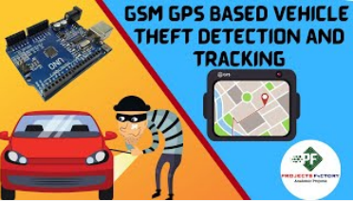
REAL LIFE EXAMPLES
1.FLIGHT TRACKING:-
GPS tracking is a way to track the location of an aircraft using satellites. GPS aircraft tracking communicates with navigation satellites to pass real-time data on flight variables to a server on the ground. This server then stores the flight data, which can be transmitted to organizations for interpretation.
2.CAR THEFT PREVENTION & SECURITY:-
Most cars are now fitted with GPS tracking devices in hidden locations. This makes it the best anti-theft protection on your vehicle. Once a car is missing, you can track the car’s present location from another device and, you can reclaim your stolen vehicle in little time.

Slide 10
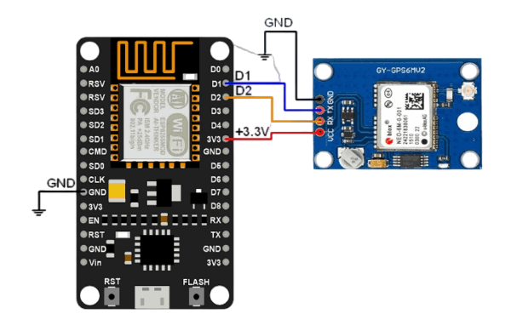
CONNECTION OF NEO-6M GPS MODULE AND WIFI MODULE

Slide 11
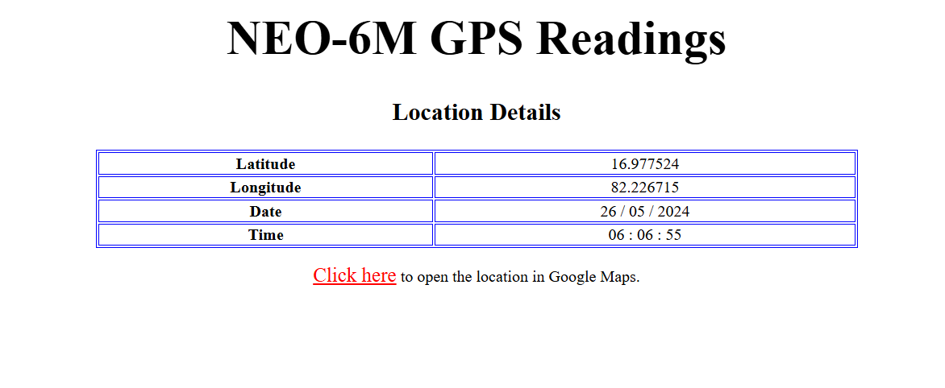
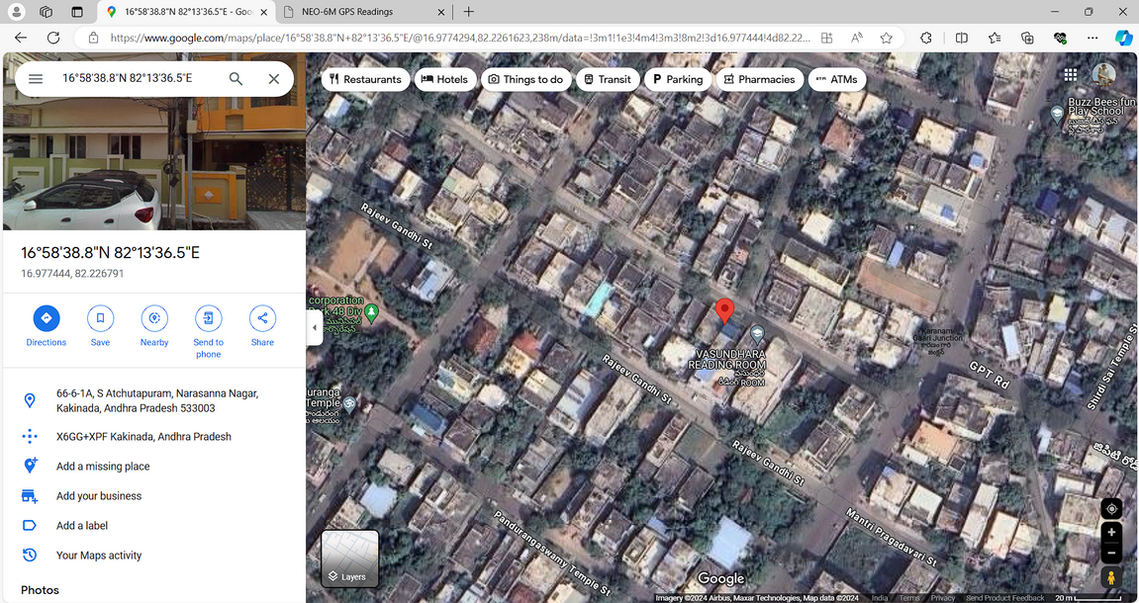
PROGRAM AND OUTPUT
#include <SoftwareSerial.h>
#include <TinyGPS++.h>
#include <ESP8266WiFi.h>
#define RX_PIN D5
#define TX_PIN D6
SoftwareSerial gpsSerial(RX_PIN, TX_PIN);
TinyGPSPlus gps;
const char* ssid = "SAI3G";
const char* password = "ramu4444";
void setup() {
Serial.begin(9600);
gpsSerial.begin(9600);
connectToWiFi();
}
void loop() {
while (gpsSerial.available() > 0) {
if (gps.encode(gpsSerial.read())) {
if (gps.location.isValid()) {
Serial.print("Latitude: ");
Serial.println(gps.location.lat(), 6);
Serial.print("Longitude: ");
Serial.println(gps.location.lng(), 6);
}
}
}
}
void connectToWiFi() {
Serial.println("Connecting to WiFi...");
WiFi.begin(ssid, password);
while (WiFi.status() != WL_CONNECTED) {
delay(1000);
Serial.print(".");
}
Serial.println("");
Serial.println("WiFi connected");
Serial.print("IP Address: ");
Serial.println(WiFi.localIP());
}

Slide 12
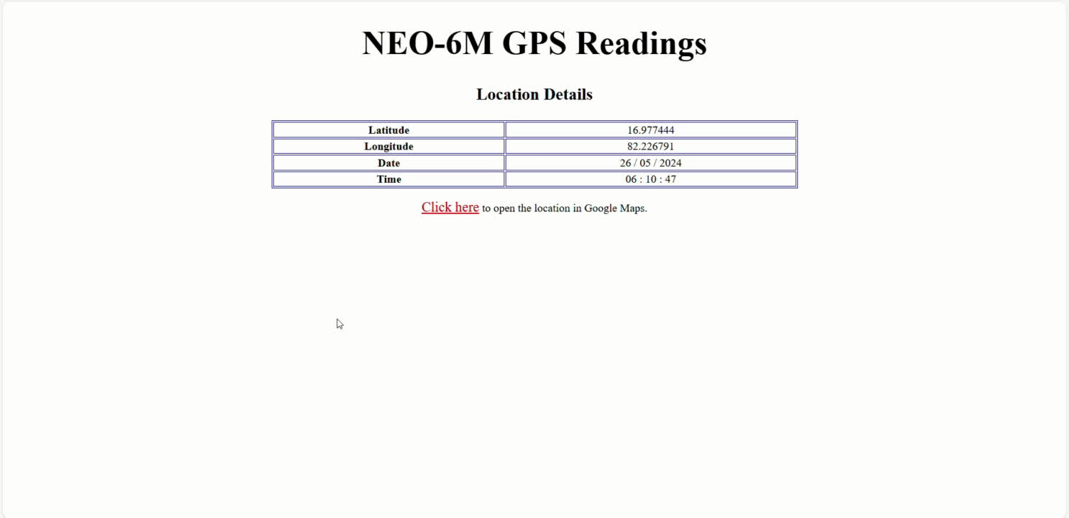
VIDEO OUTPUT OF NEO-6M GPS MODULE WITH WIFI MODULE

Slide 13
CONCLUSION
The Smart GPS Tracker project, utilizing the Neo-6M GPS Module and NodeMCU WiFi Module, successfully demonstrated an effective solution for real-time location tracking. Through the integration of these components, we were able to create a system capable of capturing accurate GPS coordinates and transmitting this data over the internet for remote monitoring. It is mainly used for Vehicle Tacking, Asset Tracking and Personal Tracking.

Slide 14
THANK YOU
By
D. Sai Ganesh

